Slide 1
Friends, Foes, and Family
Mark 3:7–35

Slide 2
Mark’s Gospel
Mark is a Gospel of action; Jesus is like a Marvel comic character.

Slide 3
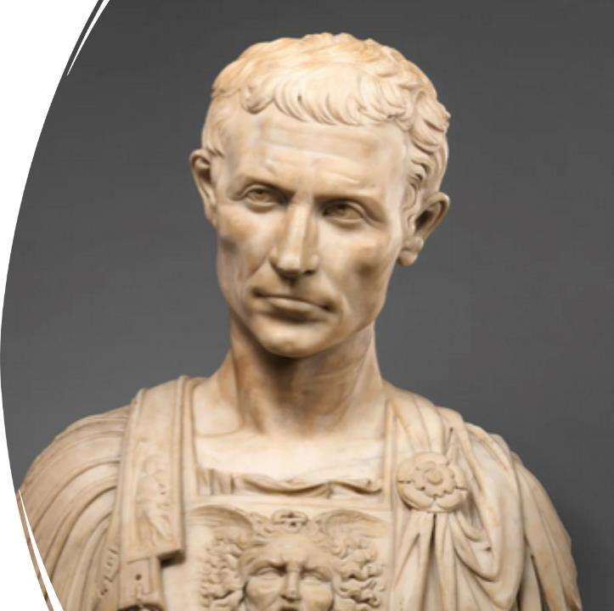
Purpose
To present Jesus as God’s anointed king (Messiah and Son of God) in opposition to Caesar, the other Son of God.
1:1; 8:29; 12:35; 14:61; 15:32, 39.

Slide 4
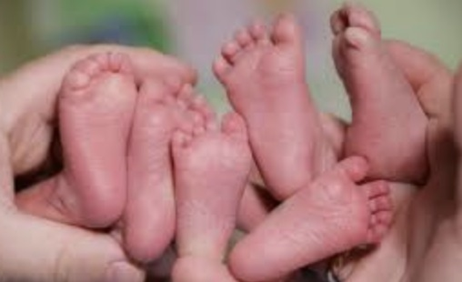
Structure
Triplets presented like a sandwich structure

Slide 5
Structure
Story 1
Story 2
Story 1
A Story Within A Story or Bracketed Stories

Slide 6
Today’s Triplet
Friends – Jesus empowered the disciples (3:7–19).
Foes – Jesus accused of serving Beelzebub (3:22–30).
Family – Jesus thought to be out of his mind (3:20–21, 31–35).

Slide 7
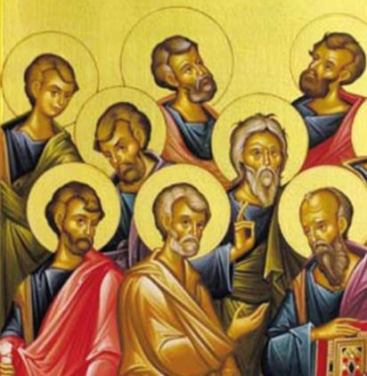
Story #1 – Friends (3:7–19)
Jesus heals people with various illnesses and chases away evil spirits who know him as “the Son of God” (3:7–12).
Jesus appoints the twelve disciples as his apostles and empowers them to preach and drive out demons (3:13–19).

Slide 8
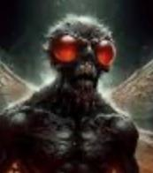
Story #2 – Foes (3:22–30)
A Story within a Story (3:20–21)
Scribes say, “He has Beelzebub. By that ruler of demons, he casts out demons” (3:22).
How can Satan, kingdom, and house stand when they are against themselves? (3:23–26).
Someone stronger than Satan has come (3:27–30).

Slide 9
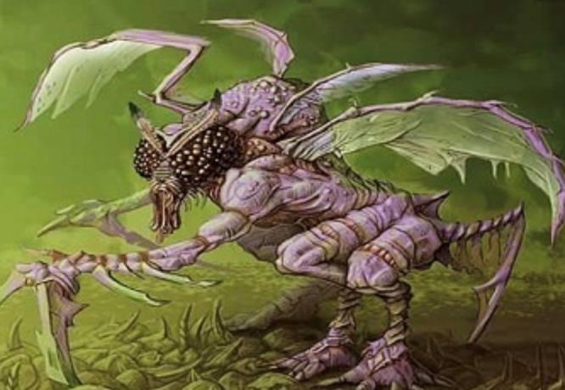
Baal-Zebub-El
In Hebrew, it is “Baal-Zebub-El, literally, “Lord-Flies-God!” or “Lord of the flies”
A Canaanite/Philistine demon/deity (daemon).
King Ahaziah appealed to this daemon for healing, and Prophet Elijah condemned him for this (2 Kings 1:2–4).

Slide 10
Story #3 – Family (3:20–21, 31–37)
The apostles return, and Jesus’s family waits for him (3:20–21).
They call for him (3:31–32).
Jesus explains genuine family relationship (3:33–35).

Slide 11
Who did they think Jesus was?
Evil spirits called him the Son of God.
Scribes thought he was the prince of demons.
The family thought he was out of his mind, a lunatic.

Slide 12
Lessons we’ve learned today
Jesus’s friends can heal and restore when he empowers them; others don’t understand us.
Jesus’s and his disciples’ power comes from the Holy Spirit, not from their strength.
Jesus’s disciples, apostles, and friends are his family — we are included.

Slide 13
Questions for us
Do we know this Jesus, who is he?
Do we believe we are Jesus’s true family even when life’s busyness or troubles weigh us down?
Do we let the Holy Spirit work in us and through us to be a blessing to others?

