Slide 1
James
FAITH
In action
James 4:1-12
Gotta Serve Somebody

Slide 2
True Wisdom
James 3:13-18

Slide 3
What causes quarrels and what causes fights among you? Is it not this, that your passions are at war within you? ² You desire and do not have, so you murder. You covet and cannot obtain, so you fight and quarrel. You do not have, because you do not ask. ³ You ask and do not receive, because you ask wrongly, to spend it on your passions. ⁴ You adulterous people! Do you not know that friendship with the world is enmity with God? Therefore whoever wishes to be a friend of the world makes himself an enemy of God. ⁵ Or do you suppose it is to no purpose that the Scripture says, “He yearns jealously over the spirit that he has made to dwell in us”?

Slide 5
James 4:1-12
Vs 1-2 – Outward conflicts the result of inward desires gone wrong.

Slide 6
James 4:1-12
Vs 1-2 – Outward conflicts the result of inward desires gone wrong.
Vs 3 - Wrong motives leading to unanswered prayer.
Vs 4-5 – Our conflict with people are a symptom of our rebellion against God.

Slide 7
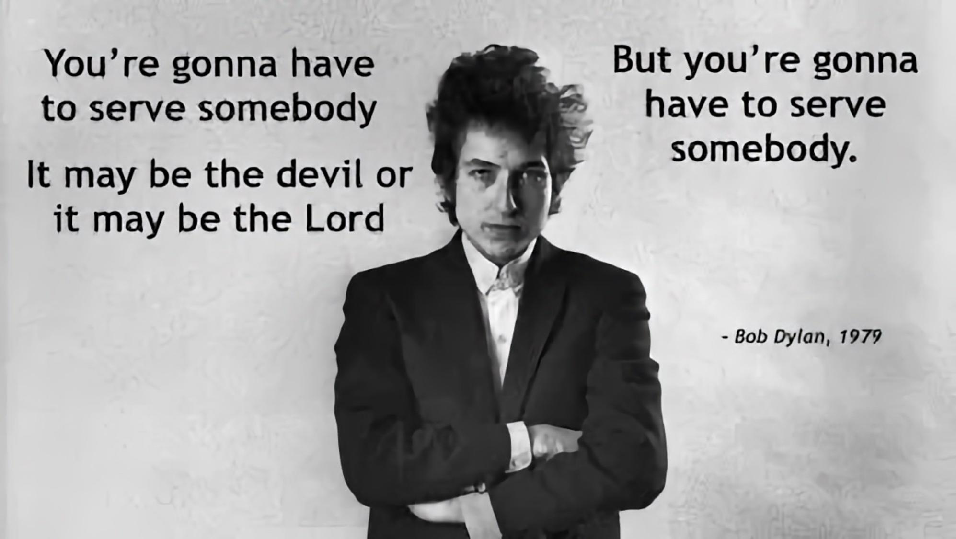

Slide 8
⁴ You adulterous people! Do you not know that friendship with the world is enmity with God? Therefore whoever wishes to be a friend of the world makes himself an enemy of God. ⁵ Or do you suppose it is to no purpose that the Scripture says, “He yearns jealously over the spirit that he has made to dwell in us”?

Slide 9
James 4:1-12
Vs 4-5
God has a rightful claim over his people – therefore he is a jealous God!
Israel – God’s people – was covenanted to Him as in a marriage.
(Isaiah 54:1-6; Jeremiah 2:2, 3:20 – see also Hosea).

Slide 10
⁶ But he gives more grace. Therefore it says, “God opposes the proud but gives grace to the humble.” ⁷ Submit yourselves therefore to God. Resist the devil, and he will flee from you. ⁸ Draw near to God, and he will draw near to you. Cleanse your hands, you sinners, and purify your hearts, you double-minded. ⁹ Be wretched and mourn and weep. Let your laughter be turned to mourning and your joy to gloom. ¹⁰ Humble yourselves before the Lord, and he will exalt you.

Slide 11
James 4:1-12
Vs 6 – He gives more grace to the humble

Slide 12
James 4:1-12
4 things we must do:
Submit to God (vs 7a).
“Submit” in Greek hypotassō - "be subject, to yield".
2) Resist the devil (vs 7b) - cf Matt. 4:1-10.
3) Draw near to God (vs 8a)
4) Weep and mourn over our sins (vs 8b-9)

Slide 13
Cleanse your hands, you sinners, and purify your hearts, you double-minded. ⁹ Be wretched and mourn and weep. Let your laughter be turned to mourning and your joy to gloom. ¹⁰ Humble yourselves before the Lord, and he will exalt you.

Slide 15
Cleanse your hands, you sinners, and purify your hearts, you double-minded. ⁹ Be wretched and mourn and weep. Let your laughter be turned to mourning and your joy to gloom. ¹⁰ Humble yourselves before the Lord, and he will exalt you.

Slide 16
“James is no killjoy, denying any place for laughter and joy in the Christian life. But ‘laughter’ in the Old Testament and Judaism is often the scornful laughter of the fool (Eccl. 7:6; Sirach 27:13) who blithely refuses to take sin seriously…. For this reason Jesus warned: ‘Woe to you who laugh now, for you will mourn and weep’ (Luke 6:25b). Mourning and weeping on the day of God’s judgment can be avoided if people mourn and weep for sin now.”
Douglas Moo, James: An Introduction and Commentary, Tyndale New Testament Commentaries, Vol 16, IVP Academic: Downers Grove, 2009, page 142

Slide 17
James 4:1-12
Vs 10 – Humble yourselves (cf vs 6 and Proverbs 3:34)

Slide 18
¹¹ Do not speak evil against one another, brothers. The one who speaks against a brother or judges his brother, speaks evil against the law and judges the law. But if you judge the law, you are not a doer of the law but a judge. ¹² There is only one lawgiver and judge, he who is able to save and to destroy. But who are you to judge your neighbour?

Slide 19
MATTHEW 18:15-18
¹⁵ “If your brother sins against you, go and tell him his fault, between you and him alone. If he listens to you, you have gained your brother. ¹⁶ But if he does not listen, take one or two others along with you, that every charge may be established by the evidence of two or three witnesses. ¹⁷ If he refuses to listen to them, tell it to the church. And if he refuses to listen even to the church, let him be to you as a Gentile and a tax collector. ¹⁸ Truly, I say to you, whatever you bind on earth shall be bound in heaven, and whatever you loose on earth shall be loose
in heaven.”

Slide 20
Where do you stand with God today?

Slide 21
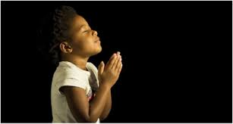
LET US PRAY….

