Slide 1
Notes:
DALL·E 2024-12-19 19.16.26 - A modern and relatable scene in Singapore depicting a young couple sitting together at a table, looking at blueprints and floor plans for their future

Slide 2
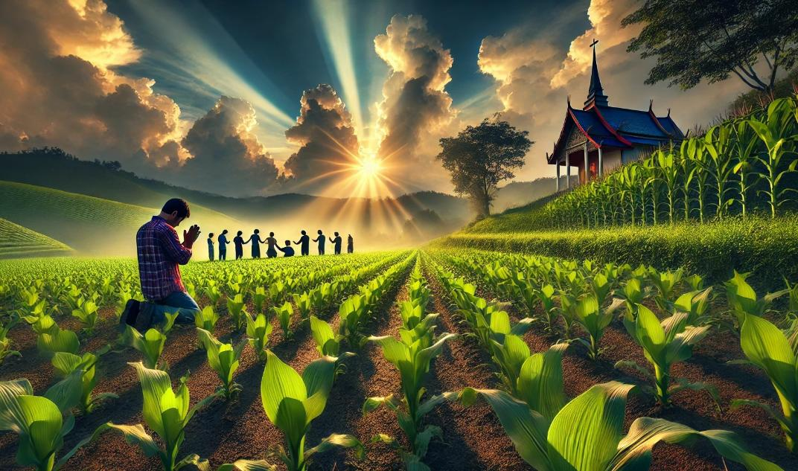
Patience and Prayer in Action
James 5:7-20

Slide 4
Rejoices in Difficulty | Obeys the Word | Avoids Favoritism | Produces Works | Speaks Wisely | Produces Humility
1:1-18 | 1:19-27 | 2:1-13 | 2:14-26 |  | 4:1–5:6
Salutation Trials Temptations | Prepare Obey | Discrimination Materialism Egalitarianism | Meeting Needs Validation | Influence Untamable Be Wise | Conflict Judging Presumption
Faith in Action . . .
3:1-18
A book summary chart of all the books of the New Testament can be found at
https://biblestudydownloads.org/resources/new-testament-survey/

Slide 5
Rejoices in Difficulty | Obeys the Word | Avoids Favoritism | Produces Works | Speaks Wisely | Produces Humility | Triumphs
1:1-18 | 1:19-27 | 2:1-13 | 2:14-26 |  | 4:1–5:6 | 5:7-20
Salutation Trials Temptations | Prepare Obey | Discrimination Materialism Egalitarianism | Meeting Needs Validation | Influence Untamable Be Wise | Conflict Judging Presumption | Suffering Prayer Confrontation
Faith in Action . . .
3:1-18
A book summary chart of all the books of the New Testament can be found at
https://biblestudydownloads.org/resources/new-testament-survey/

Slide 6
warning about Presumptuous Arrogance and Oppressive Greed
James 4:13 – 5:6

Slide 7
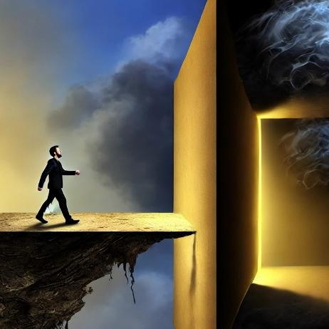
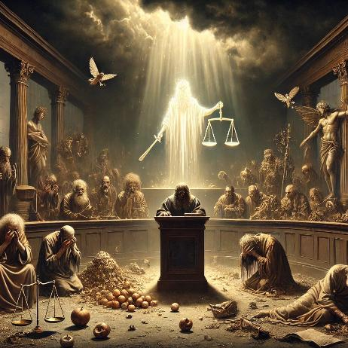
Peril for the Presumptuous
Ruin for the Rich
James 4:13-17
James 5:1-6

Slide 8
Peril for the Presumptuous
Ruin for the Rich
James 4:13-17
James 5:1-6
Come now you presumptuous
Come now you rich
Did not love God
Did not love man

Slide 9
Patience and Prayer in Action
James 5:7-20

Slide 10
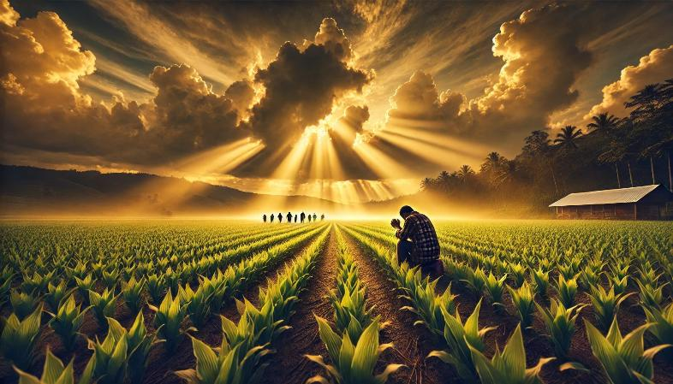
Perfecting Patience
James 5:7–12
patient
Notes:
DALL·E 2024-12-19 10.09.11 - An inspirational and serene scene for the theme 'Perfecting Patience'. The image depicts a farmer kneeling in prayer in the middle of a flourishing fi

Slide 11
⁷ Be patient, therefore, brothers, until the coming of the Lord. See how the farmer waits for the precious fruit of the earth, being patient about it, until it receives the early and the late rains. ⁸ You also, be patient. Establish your hearts, for the coming of the Lord is at hand.
patient
Patience in Waiting

Slide 12
⁷ Be patient, therefore, brothers, until the coming of the Lord.
Patience in Waiting

Slide 13
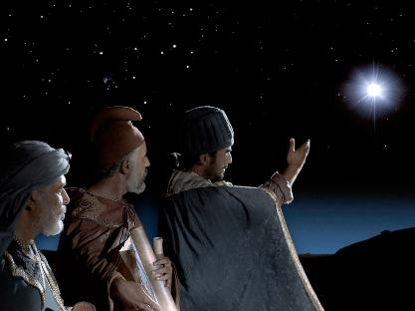
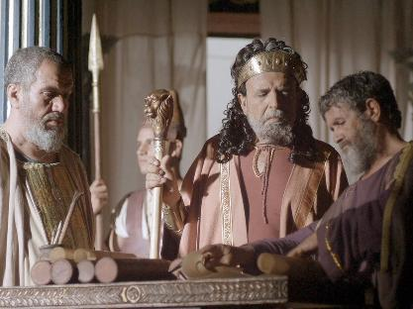
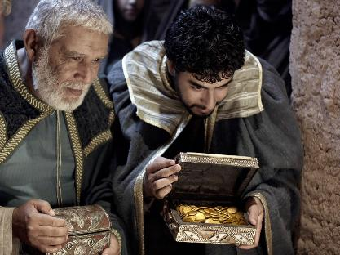
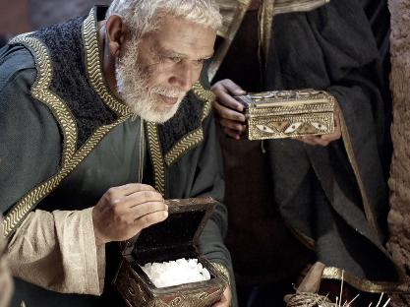
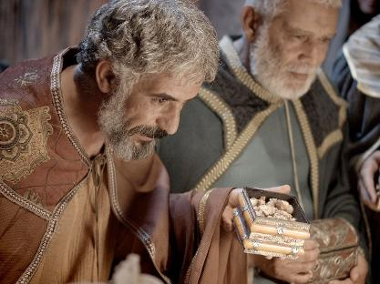
images are the copyright of the LUMO project www.LumoProject.com and are available for download at FreeBibleimages.org

Slide 14
Who were the Magi??
Numbers 24:17
I see him, but not now; I behold him, but not near: a star shall come out of Jacob, and a scepter shall rise out of Israel; it shall crush the forehead of Moab and break down all the sons of Sheth.

Slide 15
Daniel 9:24-27
Who were the Magi??
²⁴ “Seventy weeks are decreed about your people and your holy city,
to finish the transgression, to put an end to sin, and to atone for iniquity, to bring in everlasting righteousness, to seal both vision and prophet, and to anoint a most holy place.^{[b]} ²⁵ Know therefore and understand that from the going out of the word to restore and build Jerusalem to the coming of an anointed one, a prince, there shall be seven weeks. Then for sixty-two weeks it shall be built again^{[c]} with squares and moat, but in a troubled time. ²⁶ And after the sixty-two weeks, an anointed one shall be cut off and shall have nothing. And the people of the prince who is to come shall destroy the city and the sanctuary. Its^{[d]} end shall come with a flood, and to the end there shall be war. Desolations are decreed. ²⁷ And he shall make a strong covenant with many for one week,^{[e]} and for half of the week he shall put an end to sacrifice and offering. And on the wing of abominations shall come one who makes desolate, until the decreed end is poured out on the desolator.”

Slide 16
Daniel 9:24-27
Who were the Magi??
²⁴ “Seventy weeks are decreed about your people and your holy city, to finish the transgression, to put an end to sin, and to atone for iniquity, to bring in everlasting righteousness, to seal both vision and prophet, and to anoint a most holy place.^{[b]} ²⁵ Know therefore and understand that from the going out of the word to restore and build Jerusalem to the coming of an anointed one, a prince, there shall be seven weeks. Then for sixty-two weeks it shall be built again^{[c]} with squares and moat, but in a troubled time. ²⁶ And after the sixty-two weeks, an anointed one shall be cut off and shall have nothing. And the people of the prince who is to come shall destroy the city and the sanctuary. Its^{[d]} end shall come with a flood, and to the end there shall be war. Desolations are decreed. ²⁷ And he shall make a strong covenant with many for one week,^{[e]} and for half of the week he shall put an end to sacrifice and offering. And on the wing of abominations shall come one who makes desolate, until the decreed end is poured out on the desolator.”

Slide 17
Daniel 9:24-27
Who were the Magi??
²⁴ “Seventy weeks are decreed about your people and your holy city, to finish the transgression, to put an end to sin, and to atone for iniquity, to bring in everlasting righteousness, to seal both vision and prophet, and to anoint a most holy place.^{[b]} ²⁵ Know therefore and understand that from the going out of
the word to restore and build Jerusalem to the
coming of an anointed one, a prince, there shall be seven weeks. Then for sixty-two weeks it shall be built again^{[c]} with squares and moat, but in a troubled time. ²⁶ And after the sixty-two weeks, an anointed one shall be cut off and shall have nothing. And the people of the prince who is to come shall destroy the city and the sanctuary. Its^{[d]} end shall come with a flood, and to the end there shall be war. Desolations are decreed. ²⁷ And he shall make a strong covenant with many for one week,^{[e]} and for half of the week he shall put an end to sacrifice and offering. And on the wing of abominations shall come one who makes desolate, until the decreed end is poured out on the desolator.”

Slide 18
Daniel 9:24-27
Who were the Magi??
²⁴ “Seventy weeks are decreed about your people and your holy city, to finish the transgression, to put an end to sin, and to atone for iniquity, to bring in everlasting righteousness, to seal both vision and prophet, and to anoint a most holy place.^{[b]} ²⁵ Know therefore and understand that from the going out of
the word to restore and build Jerusalem to the
coming of an anointed one, a prince, there shall be seven weeks. Then for sixty-two weeks it shall be built again^{[c]} with squares and moat, but in a troubled time. ²⁶ And after the sixty-two weeks, an anointed one shall be cut off and shall have nothing. And the people of the prince who is to come shall destroy the city and the sanctuary. Its^{[d]} end shall come with a flood, and to the end there shall be war. Desolations are decreed. ²⁷ And he shall make a strong covenant with many for one week,^{[e]} and for half of the week he shall put an end to sacrifice and offering. And on the wing of abominations shall come one who makes desolate, until the decreed end is poured out on the desolator.”

Slide 19
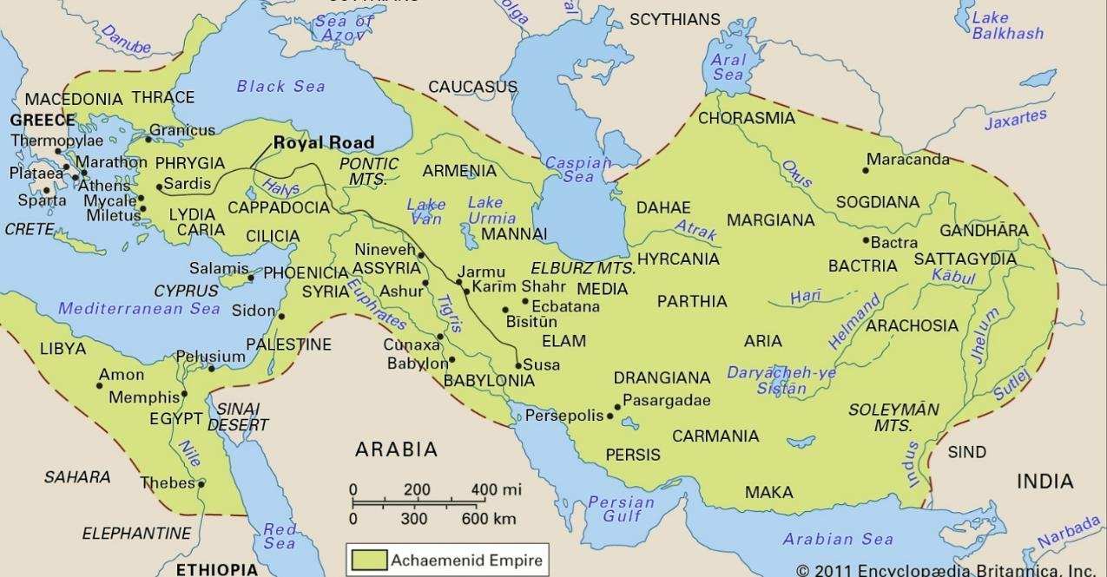
Notes:
https://www.britannica.com/event/Greco-Persian-Wars#/media/1/244117/2029
Access Date: December 20, 2024

Slide 20
How long did the Magi wait?
Who were the Magi??
Deuteronomy
1 Samuel
Leviticus
2 Samuel
Nehemiah
Genesis 1-11
Genesis 12-50
Exodus
Numbers
Joshua
Judges
1 Kings
2 Kings
Ruth
Ezra
Esther
Moses
Cycles
S • D • S
Z • E • N
1st Coming
Eternity
Creation
Joshua
J (R) & I (J)
Eternity
Fall
Babel
J (B) & I (A)
Flood
P • G • H • R
2nd Coming
Abraham
Joseph
Isaac
Jacob
1000
1990+
Exodus
Judges
Church
Kingdom
Patriarchs
Conquests
Silent Years
Beginnings
Restoration
United Kingdom
Captivity
Divided Kingdom
Max Anders, Dallas Theological Seminary

Slide 21
How long did the Magi wait?
Jeremiah 25:11-12; 29:10: The 70-year captivity of Judah
605 BC – First deportation to Babylon under Nebuchadnezzar.
536 BC – The first return of Jewish exiles under Cyrus's decree.
Daniels 9:25 70-weeks prophecy (483 years)
457 BC: Decree to rebuild Jerusalem (Artaxerxes).
27 AD: Jesus begins His ministry.
Patience in Waiting

Slide 22
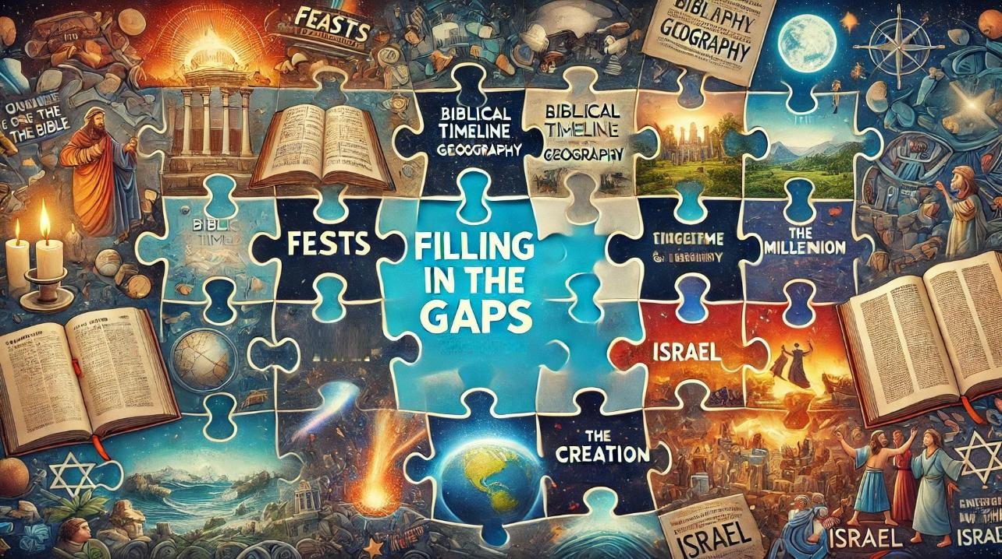

Slide 23
1. Overview / timeline / geography /
2. Canon (where did the Bible come from)
3. Creation
4. Israel
5. Feasts
6. Prophecy

Slide 24
⁷ Be patient, therefore, brothers, until the coming of the Lord.
παρουσία
parousia
parousia is consistently associated with
Jesus’ Second Coming,
when He will return in glory to judge,
establish His kingdom,
and fulfill God’s ultimate plan.
Patience in Waiting

Slide 25
Christ has Died
Christ has Risen
Christ will Come Again
Dying you destroyed our death
Rising you restored our life.
Lord Jesus, come in glory.
Memorial Acclamation

Slide 26
⁷ Be patient, therefore, brothers, until the coming of the Lord. See how the farmer waits for the precious fruit of the earth, being patient about it, until it receives the early and the late rains.
Patience in Waiting

Slide 27
⁷ Be patient, therefore, brothers, until the coming of the Lord. See how the farmer waits for the precious fruit of the earth, being patient about it, until it receives the early and the late rains. ⁸ You also, be patient. Establish your hearts, for the coming of the Lord is at hand.
Patience in Waiting

Slide 28
⁷ Be patient, therefore, brothers, until the coming of the Lord. See how the farmer waits for the precious fruit of the earth, being patient about it, until it receives the early and the late rains. ⁸ You also, be patient. Establish your hearts, for the coming of the Lord is at hand.
Patience in Waiting

Slide 29
⁷ Be patient, therefore, brothers, until the coming of the Lord. See how the farmer waits for the precious fruit of the earth, being patient about it, until it receives the early and the late rains. ⁸ You also, be patient. Establish your hearts, for the coming of the Lord is at hand.
Establish your hearts
Patience in Waiting

Slide 30
1:26 If anyone thinks he is religious and does not bridle his tongue but deceives his heart, this person's religion is worthless
3:14 But if you have bitter jealousy and selfish ambition in your hearts, do not boast and be false to the truth.
4:8 8 Draw near to God, and he will draw near to you. Cleanse your hands, you sinners, and purify your hearts, you double-minded.
5:5 You have lived on the earth in luxury and in self-indulgence. You have fattened your hearts in a day of slaughter.
Establish your hearts

Slide 31
⁷ Be patient, therefore, brothers, until the coming of the Lord. See how the farmer waits for the precious fruit of the earth, being patient about it, until it receives the early and the late rains. ⁸ You also, be patient. Establish your hearts, for the coming of the Lord is at hand. ⁹ Do not grumble against one another, brothers,
Do not grumble
Patience in Community

Slide 32
After God freed the Israelites from slavery in Egypt, they started their journey to the Promised Land. But instead of trusting God, they began to complain (or "grumble") about their situation
Their grumbling showed that they didn’t trust God’s plan, even though He had done amazing things for them, like parting the Red Sea and providing manna.
Do not grumble

Slide 33
⁷ Be patient, therefore, brothers, until the coming of the Lord. See how the farmer waits for the precious fruit of the earth, being patient about it, until it receives the early and the late rains. ⁸ You also, be patient. Establish your hearts, for the coming of the Lord is at hand. ⁹ Do not grumble against one another, brothers, so that you may not be judged; behold, the Judge is standing at the door.
the Judge is standing at the door.
Patience in Community

Slide 34
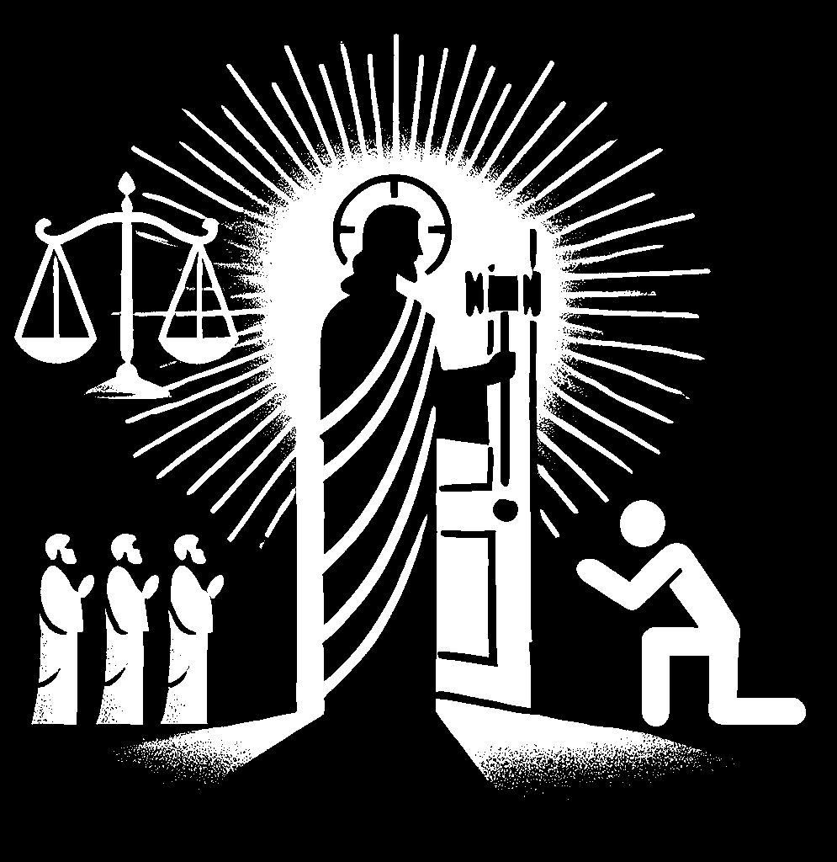
The parousia is associated with themes of resurrection, the establishment of God's eternal kingdom, the renewal of creation
and judgment,
the Judge is standing at the door.

Slide 35
¹⁰ As an example of suffering and patience, brothers, take the prophets who spoke in the name of the Lord. ¹¹ Behold, we consider those blessed who remained steadfast.
Patience in Suffering

Slide 36
¹⁰ As an example of suffering and patience, brothers, take the prophets who spoke in the name of the Lord. ¹¹ Behold, we consider those blessed who remained steadfast. You have heard of the steadfastness of Job, and you have seen the purpose of the Lord, how the Lord is compassionate and merciful.
Patience through Example

Slide 37
¹² But above all, my brothers, do not swear, either by heaven or by earth or by any other oath, but let your “yes” be yes and your “no” be no, so that you may not fall under condemnation.
Patience with Integrity

Slide 39
That’s not true! You’re always stealing my ideas and taking credit for my work. This isn’t fair!”
Actually, that idea was something I’ve been working on for a while. I appreciate that it’s being shared, and I’d be happy to explain how I developed it.”

Slide 40
Patience in Waiting (7-8)
Patience in Community (9)
Patience in Suffering (10-11a)
Patience through Examples (11b)
Patience with Integrity (12)
James 5:7-12 Perfecting Patience

Slide 41
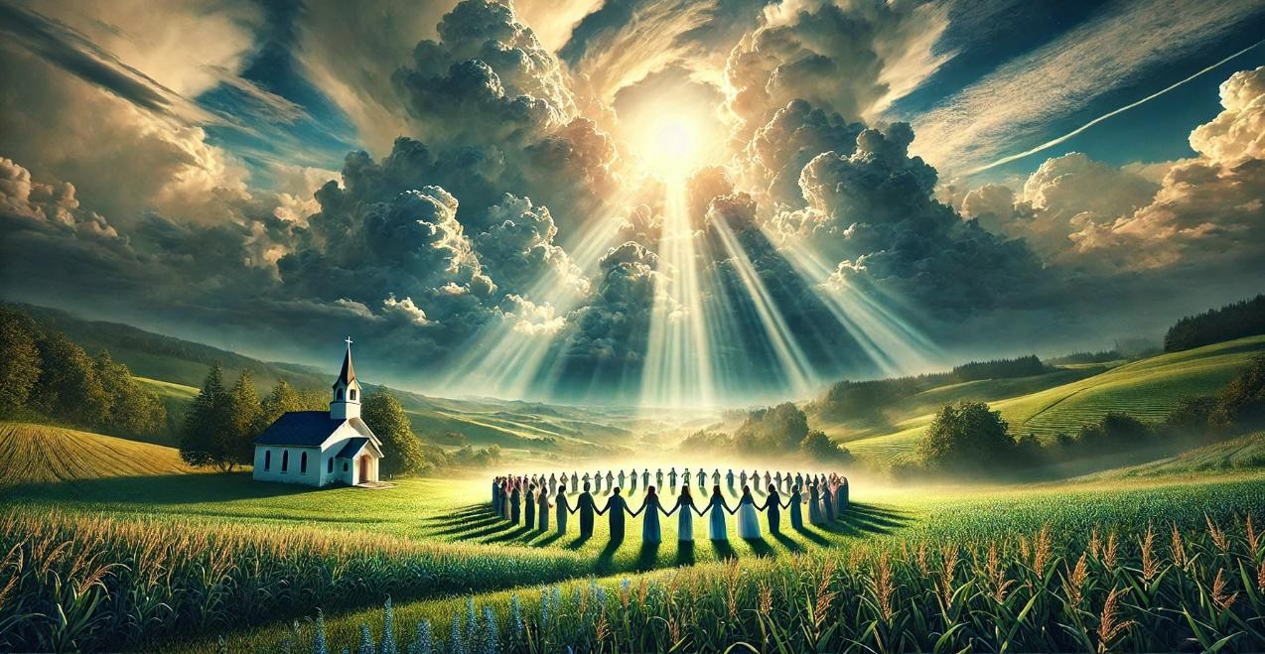
Powerful Prayers
James 5:13–20

Slide 42
¹³ Is anyone among you suffering? Let him pray. Is anyone cheerful? Let him sing praise.
¹ I will bless the Lord at all times; his praise shall continually be in my mouth. ² My soul makes its boast in the Lord; let the humble hear and be glad. ³ Oh, magnify the Lord with me, and let us exalt his name together!
Psalm 34:1-3 (ESV)
Prayer in all Season

Slide 43
¹³ Is anyone among you suffering? Let him pray. Is anyone cheerful? Let him sing praise. ¹⁴ Is anyone among you sick? Let him call for the elders of the church, and let them pray over him, anointing him with oil in the name of the Lord. ¹⁵ And the prayer of faith will save the one who is sick, and the Lord will raise him up. And if he has committed sins, he will be forgiven.
anointing
oil
Prayers of Faith

Slide 44
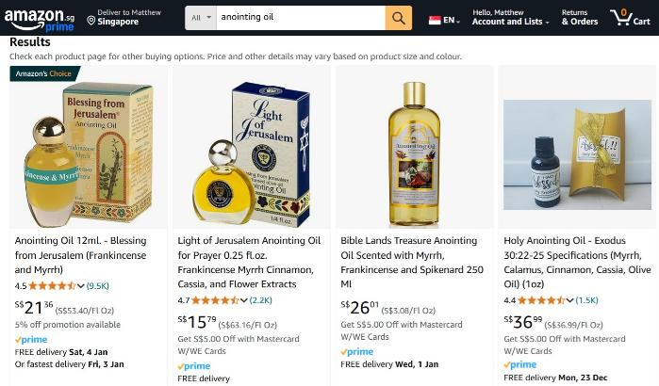
anointing
oil

Slide 45
¹³ Is anyone among you suffering? Let him pray. Is anyone cheerful? Let him sing praise. ¹⁴ Is anyone among you sick? Let him call for the elders of the church, and let them pray over him, anointing him with oil in the name of the Lord. ¹⁵ And the prayer of faith will save the one who is sick, and the Lord will raise him up. And if he has committed sins, he will be forgiven.
sick
sick
Prayers of Faith

Slide 46
¹³ Is anyone among you suffering? Let him pray. Is anyone cheerful? Let him sing praise. ¹⁴ Is anyone among you sick? Let him call for the elders of the church, and let them pray over him, anointing him with oil in the name of the Lord. ¹⁵ And the prayer of faith will save the one who is sick, and the Lord will raise him up. And if he has committed sins, he will be forgiven.
ἀσθενέω astheneō
κάμνω kamnō
sick
sick
Prayers of Faith

Slide 47
ἀσθενέω astheneō
literally means “to be weak.”
used in the Gospels for physical illness,
Matt 10:8 Heal the sick raise the dead,
Matt 25:36 I was sick you visited me
Matt 25:39 see you sick or in prison ?
Mark 6:56 they laid the sick in the marketplaces

Slide 48
ἀσθενέω astheneō
literally means “to be weak.”
used in the Gospels for physical illness,
generally used in Acts and the Epistles to refer to a weak faith or a weak conscience
Matt 10:8 Heal the sick raise the dead,
Matt 25:36 I was sick you visited me
Matt 25:39 see you sick or in prison ?
Mark 6:56 they laid the sick in the marketplaces
1 Cor 8:12 when it is weak, you sin
2 Cor 11:21 we were too weak for that!
Rom 14:1 one who is weak in faith, welcome him,
Rom 14:2 while the weak person eats only

Slide 49
¹³ Is anyone among you suffering? Let him pray. Is anyone cheerful? Let him sing praise. ¹⁴ Is anyone among you sick? Let him call for the elders of the church, and let them pray over him, anointing him with oil in the name of the Lord. ¹⁵ And the prayer of faith will save the one who is sick, and the Lord will raise him up. And if he has committed sins, he will be forgiven.
Prayers of Faith

Slide 50
κάμνω kamnō
Hebrews 12:3
Consider him who endured from sinners such hostility against himself, so that you may not grow weary or fainthearted.

Slide 51
¹³ Is anyone among you suffering? Let him pray. Is anyone cheerful? Let him sing praise. ¹⁴ Is anyone among you weary? Let him call for the elders of the church, and let them pray over him, anointing him with oil in the name of the Lord. ¹⁵ And the prayer of faith will save the one who is weary, and the Lord will raise him up. And if he has committed sins, he will be forgiven.
Prayers of Faith

Slide 52
¹⁶ Therefore, confess your sins to one another and pray for one another, that you may be healed. The prayer of a righteous person has great power as it is working. ¹⁷ Elijah was a man with a nature like ours, and he prayed fervently that it might not rain, and for three years and six months it did not rain on the earth. ¹⁸ Then he prayed again, and heaven gave rain, and the earth bore its fruit.
Prayers of the Righteous

Slide 53
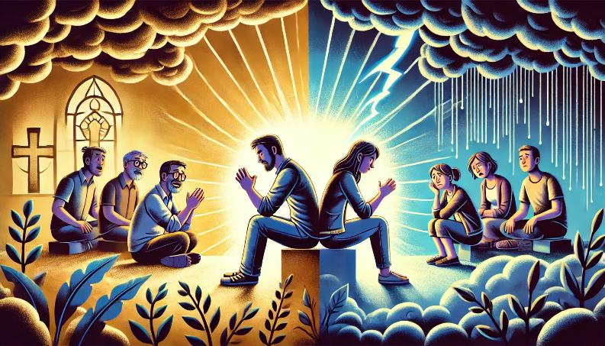
grumbling
confessing sins

Slide 54
¹⁹ My brothers, if anyone among you wanders from the truth and someone brings him back, ²⁰ let him know that whoever brings back a sinner from his wandering will save his soul from death and will cover a multitude of sins.
Prayers That Pursue

Slide 55
