Slide 1
Notes:
AI-generated image created with assistance from ChatGPT (DALL·E), 2025 with the prompt “of a single partially melted stick of butter and a metal whisk stirring the roux into 16x9 format”
DALL·E 2025-02-18 20.08.12 - A close-up, realistic depiction of cooking flour in butter to make a roux. The image shows a saucepan with a single partially melted stick of butter

Slide 2
Note magic,
but science
Starch gelatinization
Maillard reaction
Emulsification

Slide 3
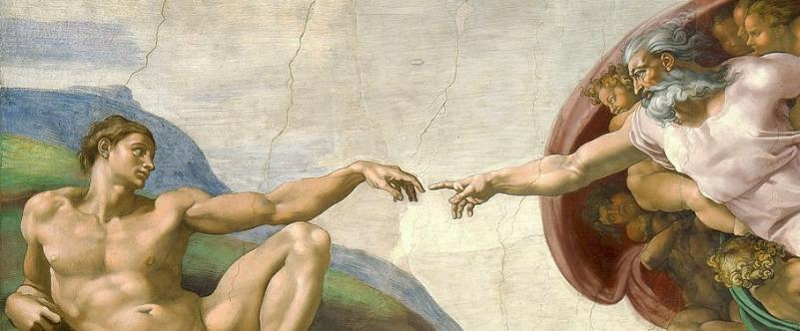
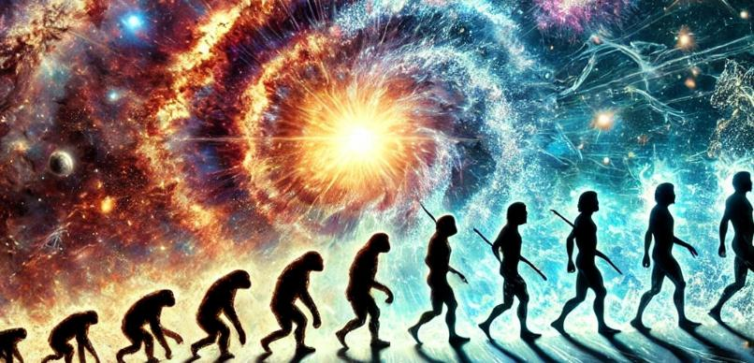
In the Beginning…
Still Relevant Today?
Notes:
And that brings us to our topic today—Creation.
Many people treat Genesis like a science textbook,
asking, “How does this compare with modern theories?”
And “is this still relevant today?”
But Genesis wasn’t written as a scientific explanation
—it was written as a revelation of
who God is,
why He created,
and what that means for us.
So today, we’re not just going to analyze the science
we’re going to open the “cookbook” of Scripture
and see what God is showing us through the story of creation.
Because just like a roux is more than just chemistry,
Creation is more than just science
—it’s the beginning of God’s plan and purpose for the world.
AI-generated image created with assistance from ChatGPT (DALL·E), 2025 with the prompt “create a 8x9 image that includes both the big bang and evolution”
DALL·E 2025-02-18 19.29.37 - A dynamic and visually striking image combining the Big Bang and evolution. On the left side, a powerful cosmic explosion represents the Big Bang
Michelangelo: The Creation of Adam, Public Domain, https://commons.wikimedia.org/w/index.php?curid=71427942

Slide 4
4
The Big Picture
From Genesis to Revelation
Notes:
Dr. Max Anders
Dallas Theological Seminary
Course 725 Summer 1984
Found on OT Survey Notes
https://biblestudydownloads.org/resources/old-testament-survey/
Pg 20
OT Survey 1 Gen-Est Low Res (19 MB)-467.pdf
https://biblestudydownloads.org/files/eng/os/OT%20Survey%201%20Gen-Est%20Low%20Res%20(19%20MB)-467.pdf
4

Slide 5
5
--------------------------------------------------------------------------1 & 2 Chronicles ----------------------------------------------------------
Deuteronomy
1 Samuel
Leviticus
2 Samuel
Nehemiah
Genesis 1-11
Genesis 12-50
Exodus
Numbers
Joshua
Judges
1 Kings
2 Kings
Ruth
Ezra
Esther
Eternity
Eternity
1000
1990+
Exodus
Judges
Church
Kingdom
Patriarchs
Conquests
Silent Years
Beginnings
Restoration
United Kingdom
Captivity
Divided Kingdom
Max Anders, Dallas Theological Seminary
Notes:
5

Slide 6
6
--------------------------------------------------------------------------1 & 2 Chronicles ----------------------------------------------------------
Deuteronomy
1 Samuel
Leviticus
2 Samuel
Nehemiah
Genesis 1-11
Genesis 12-50
Exodus
Numbers
Joshua
Judges
1 Kings
2 Kings
Ruth
Ezra
Esther
Creation
Eternity
Eternity
Fall
Babel
Flood
1000
1990+
Exodus
Judges
Church
Kingdom
Patriarchs
Conquests
Silent Years
Beginnings
Restoration
United Kingdom
Captivity
Divided Kingdom
Max Anders, Dallas Theological Seminary
Notes:
6

Slide 7
7
--------------------------------------------------------------------------1 & 2 Chronicles ----------------------------------------------------------
Deuteronomy
1 Samuel
Leviticus
2 Samuel
Nehemiah
Genesis 1-11
Genesis 12-50
Exodus
Numbers
Joshua
Judges
1 Kings
2 Kings
Ruth
Ezra
Esther
Moses
Cycles
S • D • S
Z • E • N
1st Coming
Eternity
Creation
Joshua
J (R) & I (J)
Eternity
Fall
Babel
J (B) & I (A)
Flood
P • G • H • R
2nd Coming
Abraham
Joseph
Isaac
Jacob
1000
1990+
Exodus
Judges
Church
Kingdom
Patriarchs
Conquests
Silent Years
Beginnings
Restoration
United Kingdom
Captivity
Divided Kingdom
Max Anders, Dallas Theological Seminary
Notes:
7

Slide 8
8
How should we read Genesis?
Notes:
Image provided my Microsoft 365 “designer”
8

Slide 9
9
Many people say:
Not every part of the Bible shouldn’t be taken literally
Notes:
9

Slide 10
10
Theologians say:
Not every part of the Bible shouldn’t be taken literally
Notes:
10

Slide 11
Notes:
11

Slide 12
12
²⁹ If your right eye causes you to sin,
tear it out and throw it away.
For it is better that you lose one of your members
than that your whole body be thrown into hell.
³⁰ And if your right hand causes you to sin,
cut it off and throw it away.
For it is better that you lose one of your members
than that your whole body go into hell.
Notes:
12

Slide 13
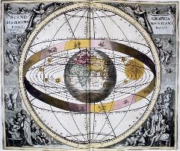
13
Geocentric model
Earth is center of universe
Sun revolves around the earth
Notes:
Media Title geocentric system
Media Type Image
Website Name Encyclopædia Britannica
Publisher Encyclopædia Britannica
URL https://www.britannica.com/science/geocentric-model#/media/1/229445/141183
Access Date February 22, 2025

Slide 14
14
Psalm 104:5 – “He set the earth on its foundations; it can never be moved.”
Ecclesiastes 1:5 – “The sun rises and the sun sets, and hurries back to where it rises.”
Joshua 10:12-13 – “Joshua said to the Lord in the presence of Israel: ‘Sun, stand still over Gibeon, and you, moon, over the Valley of Aijalon.’ So the sun stood still, and the moon stopped...”
Notes:
Media Title geocentric system
Media Type Image
Website Name Encyclopædia Britannica
Publisher Encyclopædia Britannica
URL https://www.britannica.com/science/geocentric-model#/media/1/229445/141183
Access Date February 22, 2025

Slide 15
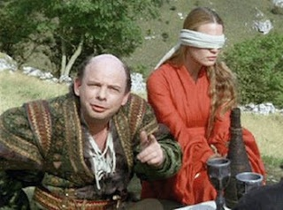
15
Aristotle and Ptolemy
The Earth was at the center of the universe.
The sun, moon, planets, and stars moved in
perfect circular orbits around it.
Notes:
Image courtesy of https://apaladinincitadel.blogspot.com/2010/10/player-skill-battle-of-wits-combat.html

Slide 16
Church accepted pseudo-science philosophical view
16

Slide 17
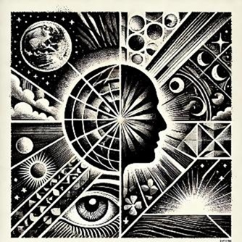
17
World View
Not Literal
Until Proven Literal
Notes:
AI-generated image created with assistance from ChatGPT (DALL·E), 2025 with the prompt “create a square black and white image that represents "worldview"
“
DALL·E 2025-02-22 15.01.37 - A square black and white illustration representing 'worldview.' The image should include___1. __A globe or Earth__ – Symbolizing a broad perspective o

Slide 18
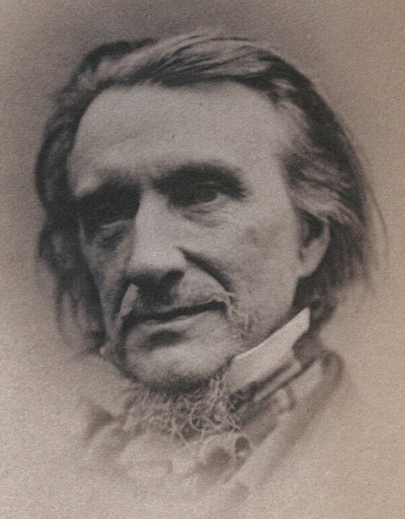
18
The Hittites
unhistorical
not exhibiting the writer’s acquaintance with the times in a very favorable light
Francis Newman
Oxford Professor
Notes:
Statement from https://armstronginstitute.org/954-finding-the-hittites#:~:text=Until%20relatively%20recently%2C%20many%20considered,evidence%20of%20the%20Bible%27s%20fallibility.
Image By J. Banks - https://www.npg.org.uk/collections/search/portrait/mw164343/Francis-William-Newman, Public Domain, https://commons.wikimedia.org/w/index.php?curid=91876961

Slide 19
19
The Hittites
Today, our understanding of the Hittites has changed dramatically. . . . we know more about the Hittites than ever. And the understanding we now have of the Hittites
closely parallels their description in the biblical record.
Notes:
https://armstronginstitute.org/954-finding-the-hittites#:~:text=Until%20relatively%20recently%2C%20many%20considered,evidence%20of%20the%20Bible%27s%20fallibility.

Slide 20
20
It is out of the question that Saul, David, and Solomon, as described as kings in the Bible, could have existed.
I think the biblical accounts are wonderful stories, invented at the time when Jerusalem was part of the Persian Empire in the fifth century B.C.
Israel Finkelstein
Ze'ev Herzog
Thomas L. Thompson
Mar 1993
Notes:
https://www.ncregister.com/blog/was-king-david-mythical-or-historical?form=MG0AV3

Slide 21
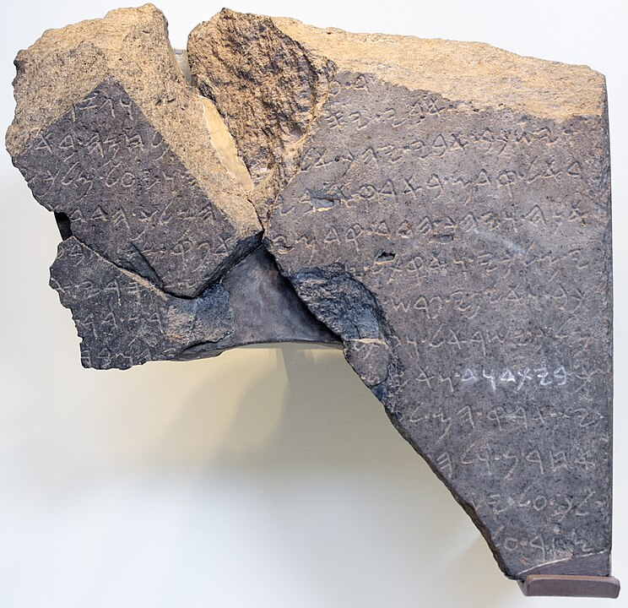
21
Archaeological evidence that proved existence of King David
Tel Dan Stele
July 1993
Notes:
By Oren Rozen - Own work, CC BY-SA 4.0, https://commons.wikimedia.org/w/index.php?curid=47055869

Slide 22
22
Where are the records?
Assyrians (2500-600 BCE):
250,000 + tablets and inscriptions
Phoenicia, Israel, Canaan
Very few written records remain

Slide 23
Nile
23

Slide 24
Turkey
Syria
Lebanon
Iran
Israel
Iraq
Jordan
Egypt
Saudi Arabia
24

Slide 25
Assyrians
Canaan
Phoenicia
Israel
Babylonians
Nile
Egyptians
25

Slide 26
Phoenicia
Bible:
Cities of Sidon and Tyre
Jezebel was from Sidon
History:
Maritime trade and shipbuilding
Purple Dye
The Alphabet
26

Slide 27
The Iliad and The Odyssey
Written by Homer 8th century BC
Oldest complete copy: 9th -10th century AD
Fragments dating to 3rd century BC
Lessons Learned:
Paper Records Don’t Last Long
Authenticity of non-biblical records not questioned
27

Slide 28
28
Based on Skepticism
(and church history)
Based on lack of evidence
(even when lack of
evidence is expected)
Treats non-Biblical sources differently
World View
Not Literal
Until Proven Literal

Slide 29
29
World View
Church View
Not Literal
Until Proven Literal
Take the Bible Literally Until you Can’t

Slide 30
30
Key to understanding:
Creation
Prophecy
Miracles
Heaven & Hell
Most Major Doctrines
Church View
Take the Bible Literally Until you Can’t

Slide 31
31
Take the Bible Literally Until you Can’t
Although there are similarities
between the Bible and other ancient stories, the differences reveal God and his character

Slide 32
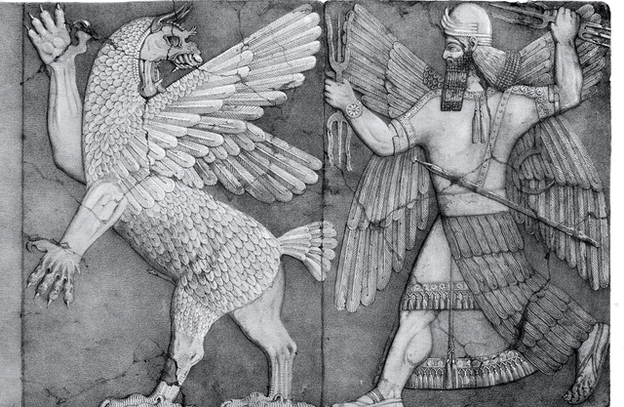
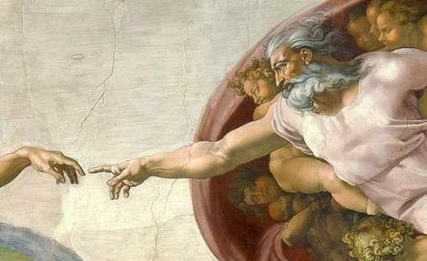
The Enuma Elish
(Babylonian Creation Myth)
Genesis
(Biblical Creation Story)
32
Notes:
By editor Austen Henry Layard , drawing by L. Gruner - 'Monuments of Nineveh, Second Series' plate 5, London, J. Murray, 1853, Public Domain, https://commons.wikimedia.org/w/index.php?curid=18217886

Slide 33
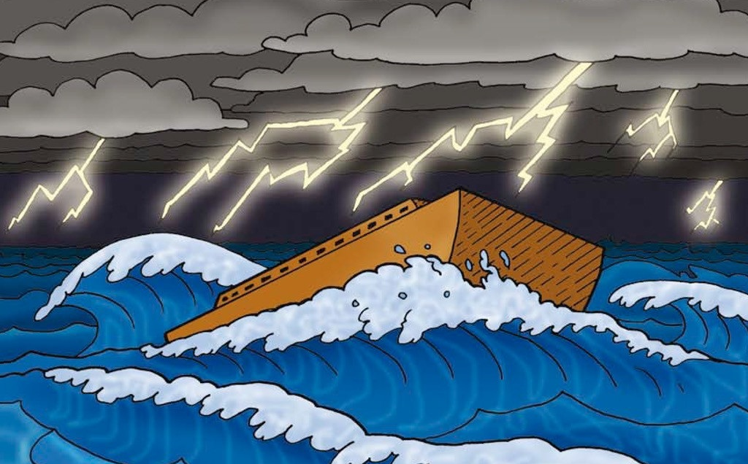
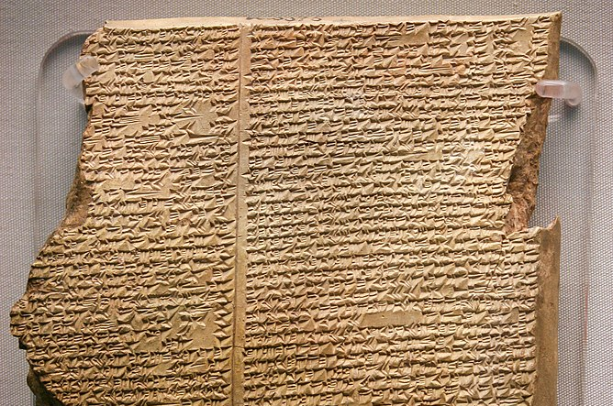
The Epic of Gilgamesh
(Sumerian Flood Myth)
Genesis
(Biblical Flood Story)
33
Notes:
"The Flood Tablet. This is perhaps the most famous of all cuneiform tablets. It is the eleventh tablet of the Gilgamesh Epic, and describes how the gods sent a flood to destroy the world. Like Noah, Utnapishtim was forewarned and built an ark to house and preserve living things. After the flood he sent out birds to look for dry land. ME K 3375.""The Flood Tablet. This is perhaps the most famous of all cuneiform tablets. It is the eleventh tablet of the Gilgamesh Epic, and describes how the gods sent a flood to destroy the world. Like Noah, Utnapishtim was forewarned and built an ark to house and preserve living things. After the flood he sent out birds to look for dry land. ME K 3375.“
By Photograph by Mike Peel (www.mikepeel.net)., CC BY-SA 4.0, https://commons.wikimedia.org/w/index.php?curid=10910031
Flood of Noah: These images were created by Rachael Coate and the text by Nancy Cunningham. They are the copyright of Basic Training Bible Ministries who have granted FreeBibleimages permission to distribute them for educational and ministry use only. They are released under a Creative Commons Attribution-NonCommercial 4.0 International License.
https://www.freebibleimages.org/illustrations/btbm-noah/

Slide 34
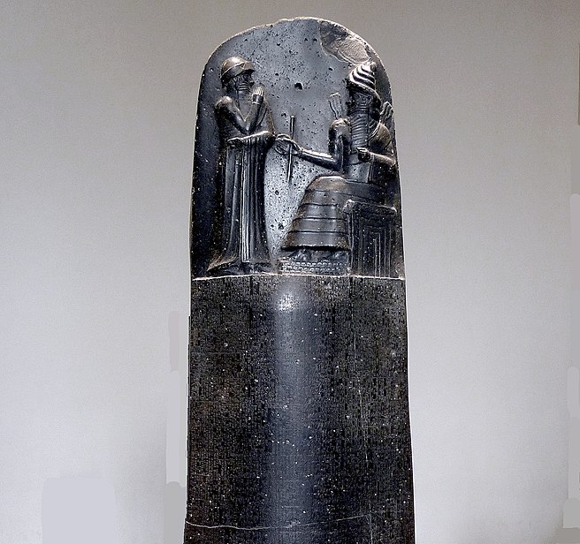
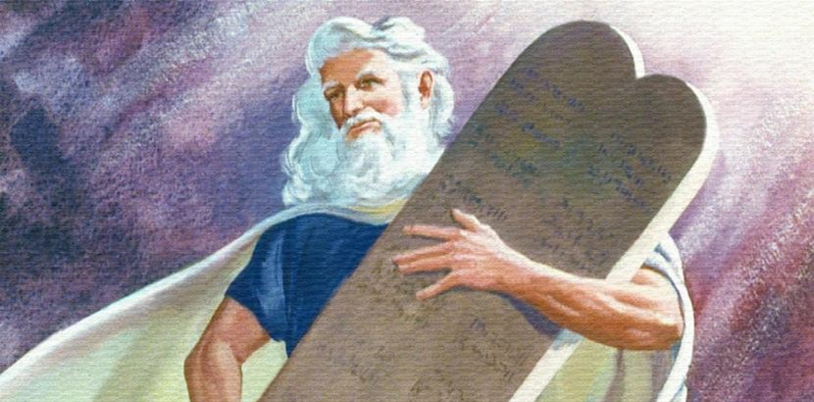
The Code of Hammurabi
(Babylonian Moral Law)
Exodus
(The Ten Commandments)
34
Notes:
The Louvre stele, By Mbzt - Own work, CC BY 3.0, https://commons.wikimedia.org/w/index.php?curid=16931676
Moses and the Ten Commandments
https://www.freebibleimages.org/illustrations/moody-moses-commandments/
These pictures are the copyright of Moody Publishers and distributed for free download under a license with FreeBibleimages for personal and educational use only. All rights reserved.
Individual Images can be used in educational presentations, web articles, blogs and social media with attribution to Moody Publishers / FreeBibleimages.org.
These images cannot be sold under any circumstances or used in any format for commercial gain.
You cannot redistribute this set of images online but you can create a link to the relevant page on FreeBibleimages.org to allow others to download these images under the same Terms of Download.
Downloaded pictures can be used in the retelling of Bible stories and narrative that are faithful to the Biblical account. They are not to be used in any context where the accompanying message is undermining of the Christian faith and gospel.

Slide 35
Babylon
12 The Lord had said to Abram,
“Go from your country, your people
and your father’s household
to the land I will show you.
35

Slide 36
36
Women
Hammurabi’s Code | Old Testament
Were treated as property under male control. | Were created in God’s image, giving them inherent value.
Laws were harsh and unequal, favoring men. | Biblical laws protected women from unjust treatment.
woman’s value depended on her fertility and obedience. | Were given property rights, legal protections, and leadership roles.
Notes:
The Louvre stele, By Mbzt - Own work, CC BY 3.0, https://commons.wikimedia.org/w/index.php?curid=16931676
Moses and the Ten Commandments
https://www.freebibleimages.org/illustrations/moody-moses-commandments/
These pictures are the copyright of Moody Publishers and distributed for free download under a license with FreeBibleimages for personal and educational use only. All rights reserved.
Individual Images can be used in educational presentations, web articles, blogs and social media with attribution to Moody Publishers / FreeBibleimages.org.
These images cannot be sold under any circumstances or used in any format for commercial gain.
You cannot redistribute this set of images online but you can create a link to the relevant page on FreeBibleimages.org to allow others to download these images under the same Terms of Download.
Downloaded pictures can be used in the retelling of Bible stories and narrative that are faithful to the Biblical account. They are not to be used in any context where the accompanying message is undermining of the Christian faith and gospel.

Slide 37
37
Ancient World View
God’s View
Women
Slaves
Same Sex Attraction

Slide 38
38
xx
Differences Reveal the Heart of God

Slide 39
Jesus Was Present at Creation
John 1:1-3
Sin Broke Creation, But Jesus Came to Redeem It Romans 8:19-22
The Resurrection:
The First Sign of the New Creation

