Slide 1

Notes:
This image was generated using OpenAI’s DALL·E and is not a photo of a real location or composition using the prompt create a 16x9 realistic collage of famous architectural buildings in Singapore

Slide 2
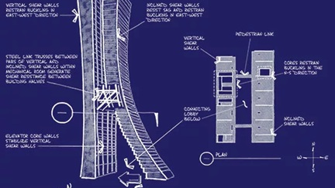
Notes:
https://en.wikiarquitectura.com/building/marina-bay-sands/#marina-bay-sand-sist-lat-estabilidad-torres

Slide 3
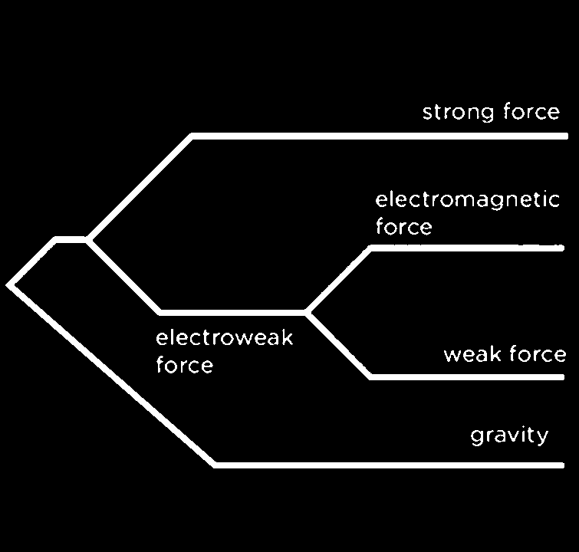
Physics
Seeks:
Grand
Unified
Theory
G
U
T
3
Notes:
https://www.secretsofuniverse.in/sheldon-lee-glashow/

Slide 4
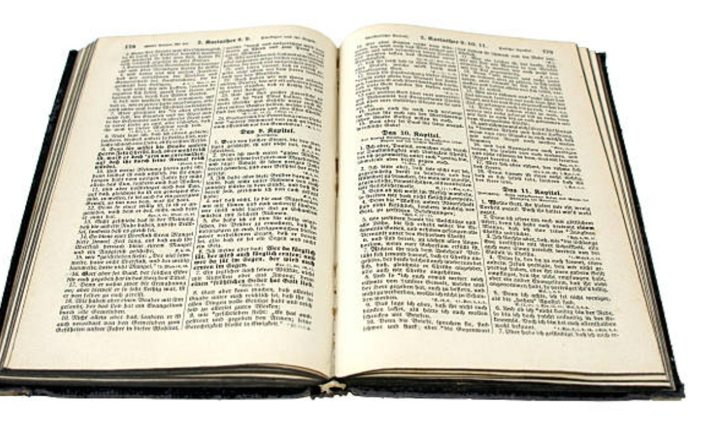
Scripture
Reveals:
God’s
Ultimate
Truth
G
U
T
4
Notes:
https://www.secretsofuniverse.in/sheldon-lee-glashow/

Slide 5

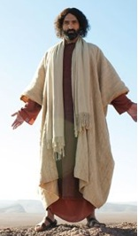
5
science seeks to understand how . . .
Scripture tells us who holds it all together: “He is before all things, and in Him all things hold together.” (Colossians 1:17)
5

Slide 6
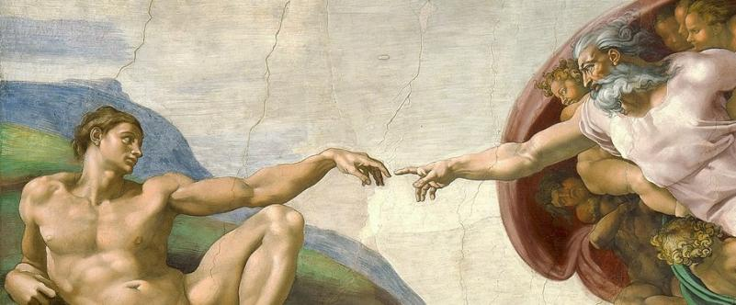
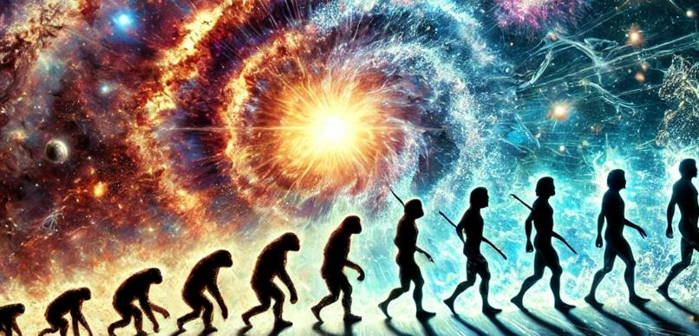
In the Beginning…
Still Relevant Today?
6
Notes:
AI-generated image created with assistance from ChatGPT (DALL·E), 2025 with the prompt “create a 8x9 image that includes both the big bang and evolution”
DALL·E 2025-02-18 19.29.37 - A dynamic and visually striking image combining the Big Bang and evolution. On the left side, a powerful cosmic explosion represents the Big Bang
Michelangelo: The Creation of Adam, Public Domain, https://commons.wikimedia.org/w/index.php?curid=71427942

Slide 7
Take the Bible Literally Until you Can’t
7

Slide 8
Take the Bible Literally Until you Can’t
Although there are similarities
between the Bible and other ancient stories, the differences reveal God and his character
8

Slide 9
Creation . . .
only the Beginning!
9

Slide 10
Creation is only the beginning
Gen 1 & 2: In the Garden
Gen 3: Out of the Garden
Gen 4: Beyond the Garden
10

Slide 11

11
TABLE OF CONTENTS
Gen 1 & 2: In the Garden
Notes:
https://www.grammarly.com/blog/academic-writing/table-of-contents/

Slide 12

TABLE OF CONTENTS
intro
In the Beginning
Gen 1:1
intro | In the Beginning | Gen 1:1
Section | Generations of . . . | location
1 | the heavens and the earth | Gen 2:4
2 | Adam | Gen 5:1
3 | Noah | Gen 6:9
4 | Sons of Noah | Gen 10:1
5 | Shem | Gen 11:10
6 | Terah | Gen 11:27
7 | Ishmael | Gen 25:12
8 | Isaac | Gen 25:19
9 | Esau (immediate family) | Gen 36:1
10 | Esau (detailed genealogy) | Gen 36:9
11 | Jacob | Gen 37:2
12
Notes:
https://www.grammarly.com/blog/academic-writing/table-of-contents/

Slide 13
³¹ And God saw everything that he had made, and behold, it was very good. And there was evening and there was morning, the sixth day.
Ch 2 ¹ Thus the heavens and the earth were finished, and all the host of them. ² And on the seventh day God finished his work that he had done, and he rested on the seventh day from all his work that he had done. ³ So God blessed the seventh day and made it holy, because on it God rested from all his work that he had done in creation.
⁴ These are the generations of the heavens and the earth when they were created, in the day that the Lord God made the earth and the heavens.
13

Slide 14
TABLE OF CONTENTS
intro
In the Beginning
Gen 1:1-2:3
intro | In the Beginning | Gen 1:1-2:3
Section | Generations of . . . | location
1 | the heavens and the earth | Gen 2:4
2 | Adam | Gen 5:1
3 | Noah | Gen 6:9
4 | Sons of Noah | Gen 10:1
5 | Shem | Gen 11:10
6 | Terah | Gen 11:27
7 | Ishmael | Gen 25:12
8 | Isaac | Gen 25:19
9 | Esau (immediate family) | Gen 36:1
10 | Esau (detailed genealogy) | Gen 36:9
11 | Jacob | Gen 37:2
14
Notes:
https://www.grammarly.com/blog/academic-writing/table-of-contents/

Slide 15
intro
In the Beginning
Gen 1:1-2:3
intro
In the Beginning
Gen 1:1-2:3
9x “And God said…”
6 DAYS 7x . . .. was (very) good”
3x God’s blessings
Forming | Filling
Day 1: Light and darkness (time, day and night) | Day 4: Sun, moon, and stars (to govern day and night)
Day 2: Sky and waters (separation of waters above and below) | Day 5: Birds and sea creatures (to fill sky and sea)
Day 3: Dry land and vegetation | Day 6: Land animals and humans (to dwell on land and eat vegetation)
15

Slide 16


intro
In the Beginning
Gen 1:1-2:3
intro
In the Beginning
Gen 1:1-2:3
poetry
Historical Narrative
16

Slide 17


Bible: Literal or Metaphor
17
xx

Slide 18
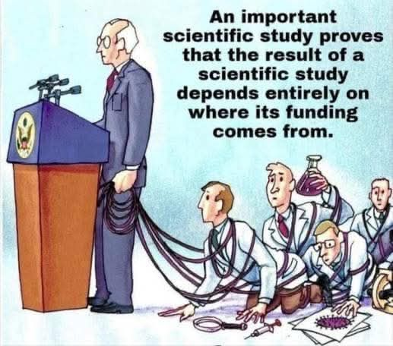
Science
NOT
Settled
18
Notes:
https://www.facebook.com/groups/463786557152746/posts/2810016599196385/

Slide 19
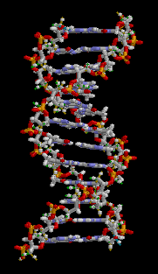
Science
NOT
Settled
19
Notes:
By brian0918&#153; - Own work, Public Domain, https://commons.wikimedia.org/w/index.php?curid=404735

Slide 20
Creation is only the beginning
20

Slide 21
Creation is only the beginning
Made for More: What God Actually Intended in the Beginning
21

Slide 22
Made for More: What God Actually Intended in the Beginning
1. You Were Created on Purpose
2. Your Work Reflects God’s Work
3. You Were Made for Relationship
4. Creation Is Meant to Point You to the Creator
5. You Were Made for More Than Survival
22

Slide 23
Creation is only the beginning
Made for More: What God Actually Intended in the Beginning
That Didn’t Last Long: How Sin and Death Crashed the Party
23

Slide 24
That Didn’t Last Long: How Sin and Death Crashed the Party
1. Temptation Twists God’s Word
2. Sin Looks Good, Feels Right — But Isn’t
3. Shame Leads Us to Hide, Not Heal
4. Passing the Blame Doesn’t Remove the Guilt
5. God Judges Sin — But Also Covers Shame
24

Slide 25
Creation is only the beginning
Made for More: What God Actually Intended in the Beginning
That Didn’t Last Long: How Sin and Death Crashed the Party
Grace in the Aftermath: When God Doesn’t Give Up on Messy People
25

Slide 26
Grace in the Aftermath: When God Doesn’t Give Up on Messy People
1. God Cares About the Heart Behind Your Offering
2. Deal With Jealousy Before It Masters You
3. Real Manhood Takes Responsibility
4. Sin Has Real Consequences, But God’s Grace Still Reaches
5. Build a Legacy That Honors God
26

Slide 27
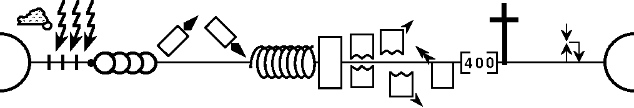
--------------------------------------------------------------------------1 & 2 Chronicles ----------------------------------------------------------
Deuteronomy
1 Samuel
Leviticus
2 Samuel
Nehemiah
Genesis 1-11
Genesis 12-50
Exodus
Numbers
Joshua
Judges
1 Kings
2 Kings
Ruth
Ezra
Esther
Moses
Cycles
S • D • S
Z • E • N
1st Coming
Eternity
Creation
Joshua
J (R) & I (J)
Eternity
Fall
Babel
J (B) & I (A)
Flood
P • G • H • R
2nd Coming
Abraham
Joseph
Isaac
Jacob
1000
1990+
Exodus
Judges
Church
Kingdom
Patriarchs
Conquests
Silent Years
Beginnings
Restoration
United Kingdom
Captivity
Divided Kingdom
27
Max Anders, Dallas Theological Seminary
Notes:
Dr. Max Anders
Dallas Theological Seminary
Course 725 Summer 1984
Found on OT Survey Notes
https://biblestudydownloads.org/resources/old-testament-survey/
Pg 20
OT Survey 1 Gen-Est Low Res (19 MB)-467.pdf
https://biblestudydownloads.org/files/eng/os/OT%20Survey%201%20Gen-Est%20Low%20Res%20(19%20MB)-467.pdf
27

Slide 28
Genesis 1–3 | Revelation 20–22
God | God
First heaven and earth | Last heaven and earth
First rest | Final rest
Paradise lost | Paradise regained
Tree and river | Tree and river
Husband and wife | Lamb and Bride
28
Hall, T. (1985). Bible Panorama (p. 29). Victor Books: A Division of SP Publications, Inc.

Slide 29
Genesis 1–3 | Revelation 20–22
Satan victorious | Satan defeated
Judgment pronounced | Judgment executed
God's face hidden | We shall see His face
Curse pronounced | Curse removed
Gates shut | Gates never shut
Death enters | Death is no more
Tears begin | Tears wiped away
Night brings fear | No night, no fear
Tree of life forbidden | Tree of life freely offered
Exile from the garden | Inheritance of the city
Cherubim guard the way | Cherubim welcome us in
29
Hall, T. (1985). Bible Panorama (p. 29). Victor Books: A Division of SP Publications, Inc.

Slide 30
Creation is only the beginning
Genesis 1–3 is not a standalone myth or fable, but the starting point of a unified biblical story.
30

Slide 31
Creation Shows God’s Original Intent for Humanity
God created all things good.
Humanity, made in His image (1:27), was designed for fellowship, stewardship, and eternal life.
31

Slide 32
The Fall Explains the Origin of Sin and Death
Adam and Eve’s disobedience introduced sin, shame, separation from God, and death—both spiritual and physical.
The curse affected creation itself.
32

Slide 33
Sin Has Real Consequences, But God’s Grace Still Reaches
Sin escalates quickly—envy turns into murder.
God confronts Cain: “Sin is crouching at your door… but you must rule over it.” (Gen 4:7)
After judgment, God still shows grace: He protects Cain from being killed (Gen 4:15).
33

Slide 34


