Slide 1
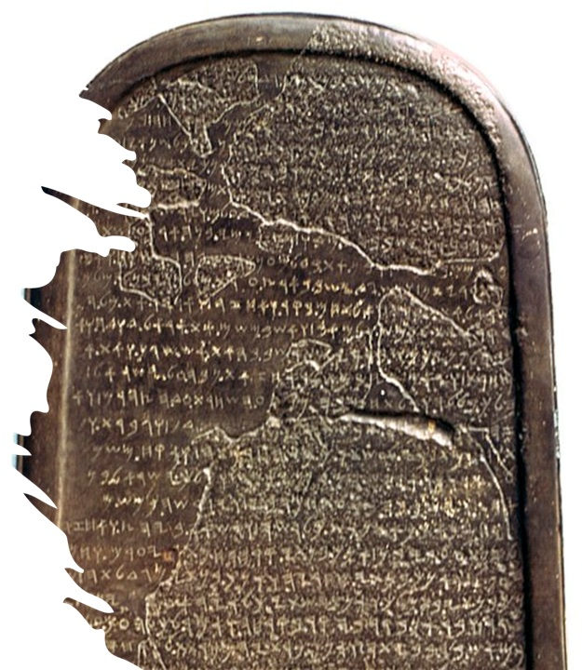
God’s Commandments More Than Anything
Mark 7:1–37

Slide 3
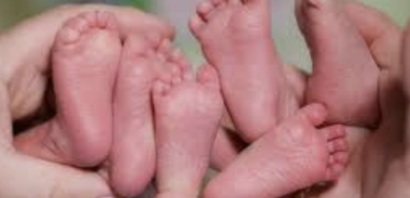
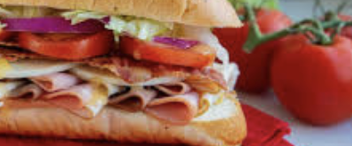
Structure
Triplets presented like a sandwich structure.

Slide 4
Today’s Triplets
Story 1 – Cleansing One’s Hands Before Eating, 7:1–23
Story 2 – A Greek Wanting Healing, 7:24–30
Story 3 – Healing with an Unclean Method, 7:31–37

Slide 5
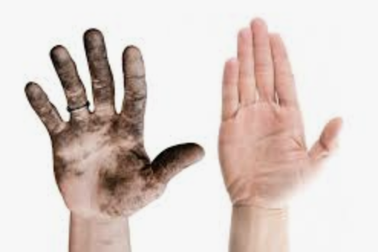
Story #1 – Eating with Unwashed Hands (7:1–23)
Traditions of the elders versus the commandments of God
Isaiah 29:13; Exodus 21:7 versus corban
Not what goes in, but what comes out

Slide 6
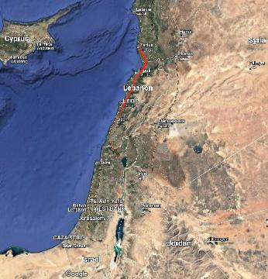

Slide 7
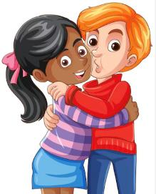
Story #2 – A Greek Wanting Healing (7:24–30)
A Greek Syrophoenician versus a Pure Hebrew of Hebrew from Galilee
A mother with an afflicted daughter and a healer
Faith that goes beyond prejudice!

Slide 8
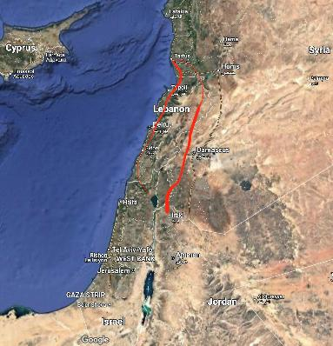

Slide 9
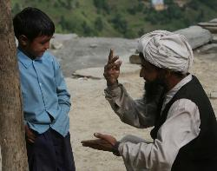
Story #3 – Healing with an Unclean Method (7:31–37)
A deaf person with a speech impediment
Healing with an unclean method

Slide 10
Lessons we’ve learned today
God is more concerned about our hearts and what comes from our mouths than human traditions.
What matters to God is one’s faith, not one’s race, ethnicity, gender, color, or creed.
Faith accepts even unfamiliar practices.

Slide 11
Question for us
Where should we need to grow—in obeying God’s commandments more than people’s traditions, accepting others who differ from us, or accepting cultural practices that differ from ours because they, too, are of faith?

