Slide 1
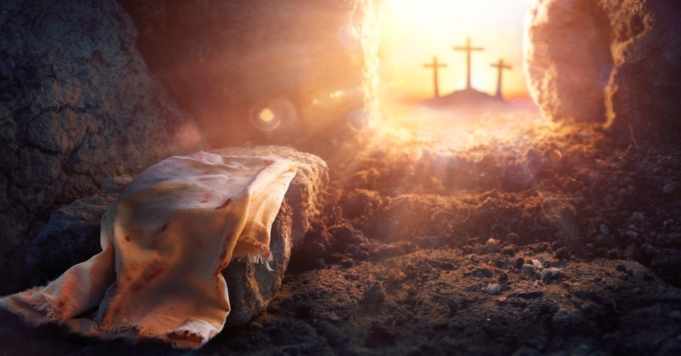
Sunday 20th April
Easter Sunday
God Intended it for Good!

Slide 2
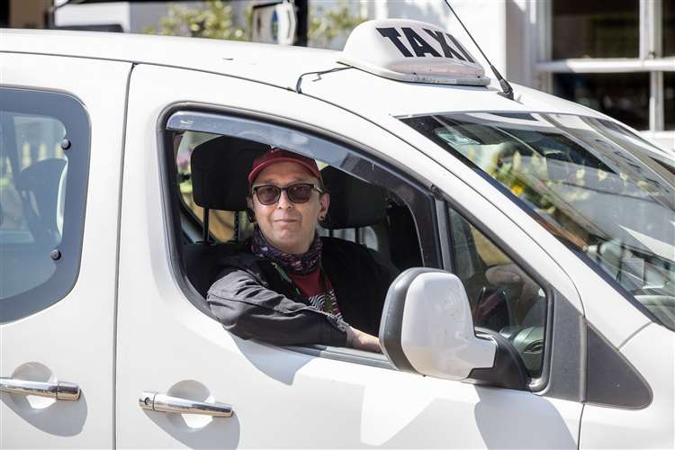

Slide 3
Sunday 20th April
Easter Sunday
God Intended it for Good!

Slide 4
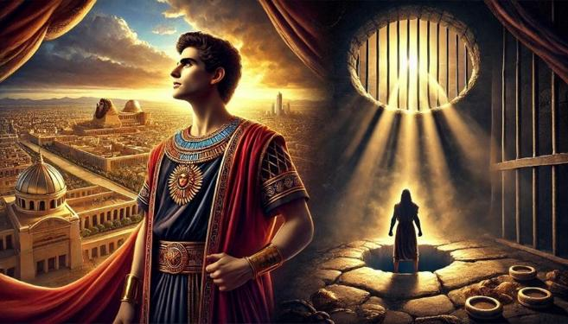
Joseph: From Pit to Prison to Palace
6

Slide 5
7

Slide 6
8

Slide 7
9

Slide 8
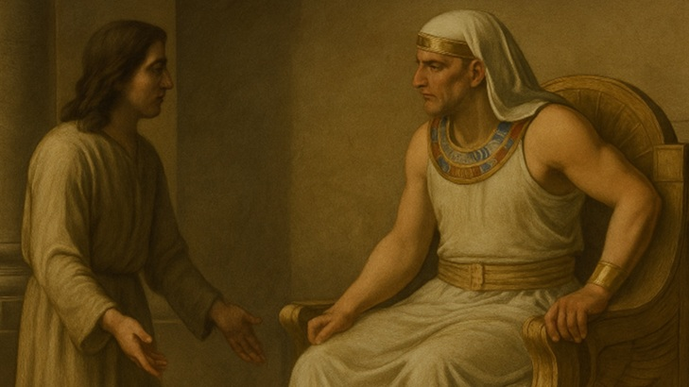
The Great Reversal
Joseph in Charge
Gen 41
10

Slide 9
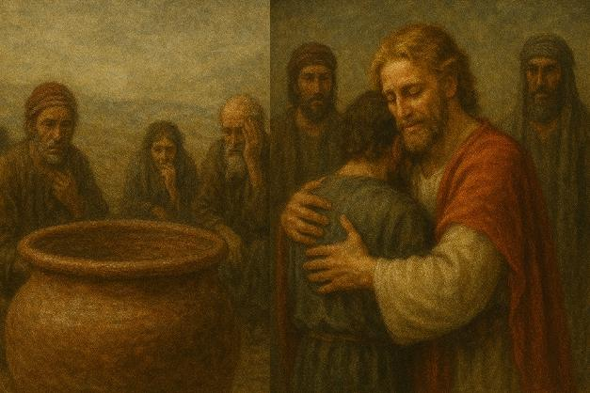
A Story of Redemption:
From Crisis to Compassion
Gen 42-45:15
12

Slide 10
²⁵ So they went up out of Egypt and came to the land of Canaan to their father Jacob. ²⁶ And they told him, “Joseph is still alive, and he is ruler over all the land of Egypt.” And his heart became numb, for he did not believe them. ²⁷ But when they told him all the words of Joseph, which he had said to them, and when he saw the wagons that Joseph had sent to carry him, the spirit of their father Jacob revived. ²⁸ And Israel said, “It is enough; Joseph my son is still alive. I will go and see him before I die.”
^{46:1} So Israel took his journey with all that he had and came to Beersheba, and offered sacrifices to the God of his father Isaac. ² And God spoke to Israel in visions of the night and said, “Jacob, Jacob.” And he said, “Here I am.”

Slide 11
³ Then he said, “I am God, the God of your father. Do not be afraid to go down to Egypt, for there I will make you into a great nation. ⁴ I myself will go down with you to Egypt, and I will also bring you up again, and Joseph's hand shall close your eyes.”
⁵ Then Jacob set out from Beersheba. The sons of Israel carried Jacob their father, their little ones, and their wives, in the wagons that Pharaoh had sent to carry him. ⁶ They also took their livestock and their goods, which they had gained in the land of Canaan, and came into Egypt, Jacob and all his offspring with him, ⁷ his sons, and his sons' sons with him, his daughters, and his sons' daughters. All his offspring he brought with him into Egypt.

Slide 12
God Intended it for Good
Jacob was shocked at the news that Joseph was alive!
“His heart became numb, for he did not believe them.” (vs 26). Compare with the disciples in Luke 24:11.
They go down to Beersheba – “Well of the Seven” where Abraham called on the name of the Lord (Gen 21:33) and where God appeared to Isaac (Gen 26:24). Now God speaks to Jacob (Gen 46:3).

Slide 13
³ Then he said, “I am God, the God of your father. Do not be afraid to go down to Egypt, for there I will make you into a great nation. ⁴ I myself will go down with you to Egypt, and I will also bring you up again, and Joseph's hand shall close your eyes.”
⁵ Then Jacob set out from Beersheba. The sons of Israel carried Jacob their father, their little ones, and their wives, in the wagons that Pharaoh had sent to carry him. ⁶ They also took their livestock and their goods, which they had gained in the land of Canaan, and came into Egypt, Jacob and all his offspring with him, ⁷ his sons, and his sons' sons with him, his daughters, and his sons' daughters. All his offspring he brought with him into Egypt.

Slide 14
God Intended it for Good
Jacob was shocked at the news that Joseph was alive!
“His heart became numb, for he did not believe them.” (vs 26 – compare with the disciples in Luke 24:11.
They go down to Beersheba – “Well of the Seven” where Abraham called on the name of the Lord (Gen 21:33) and where God appeared to Isaac (Gen 26:24). Now God speaks to Jacob (Gen 46:3).
Jacob makes Joseph promise to bury him in Canaan with his fathers (Gen 47:29-31).

Slide 15
¹⁵ When Joseph's brothers saw that their father was dead, they said, “It may be that Joseph will hate us and pay us back for all the evil that we did to him.” ¹⁶ So they sent a message to Joseph, saying, “Your father gave this command before he died: ¹⁷ ‘Say to Joseph, “Please forgive the transgression of your brothers and their sin, because they did evil to you.”’ And now, please forgive the transgression of the servants of the God of your father.” Joseph wept when they spoke to him. ¹⁸ His brothers also came and fell down before him and said, “Behold, we are your servants.” ¹⁹ But Joseph said to them, “Do not fear, for am I in the place of God? ²⁰ As for you, you meant evil against me, but God meant it for good, to bring it about that many people should be kept alive, as they are today. ²¹ So do not fear; I will provide for you and your little ones.” Thus he comforted them and spoke kindly to them.

Slide 17
¹⁵ When Joseph's brothers saw that their father was dead, they said, “It may be that Joseph will hate us and pay us back for all the evil that we did to him.” ¹⁶ So they sent a message to Joseph, saying, “Your father gave this command before he died: ¹⁷ ‘Say to Joseph, “Please forgive the transgression of your brothers and their sin, because they did evil to you.”’ And now, please forgive the transgression of the servants of the God of your father.” Joseph wept when they spoke to him. ¹⁸ His brothers also came and fell down before him and said, “Behold, we are your servants.” ¹⁹ But Joseph said to them, “Do not fear, for am I in the place of God? ²⁰ As for you, you meant evil against me, but God meant it for good, to bring it about that many people should be kept alive, as they are today. ²¹ So do not fear; I will provide for you and your little ones.” Thus he comforted them and spoke kindly to them.

Slide 18
Joseph and Jesus
As our Lord Jesus, Joseph is the object of his father’s special love.
As our Lord Jesus, he was mocked by his family.
As our Lord Jesus, he was sold for pieces of silver, and stripped of his robe.
Joseph was also falsely accused.
Joseph also stood before rulers.
Joseph also saved his rebellious brothers from death when they realised who he was.
He was exalted after and through humiliation.
He embraced God’s purpose even though it brought him intense physical harm.
Finally, people come and bow their knee before him.

Slide 19
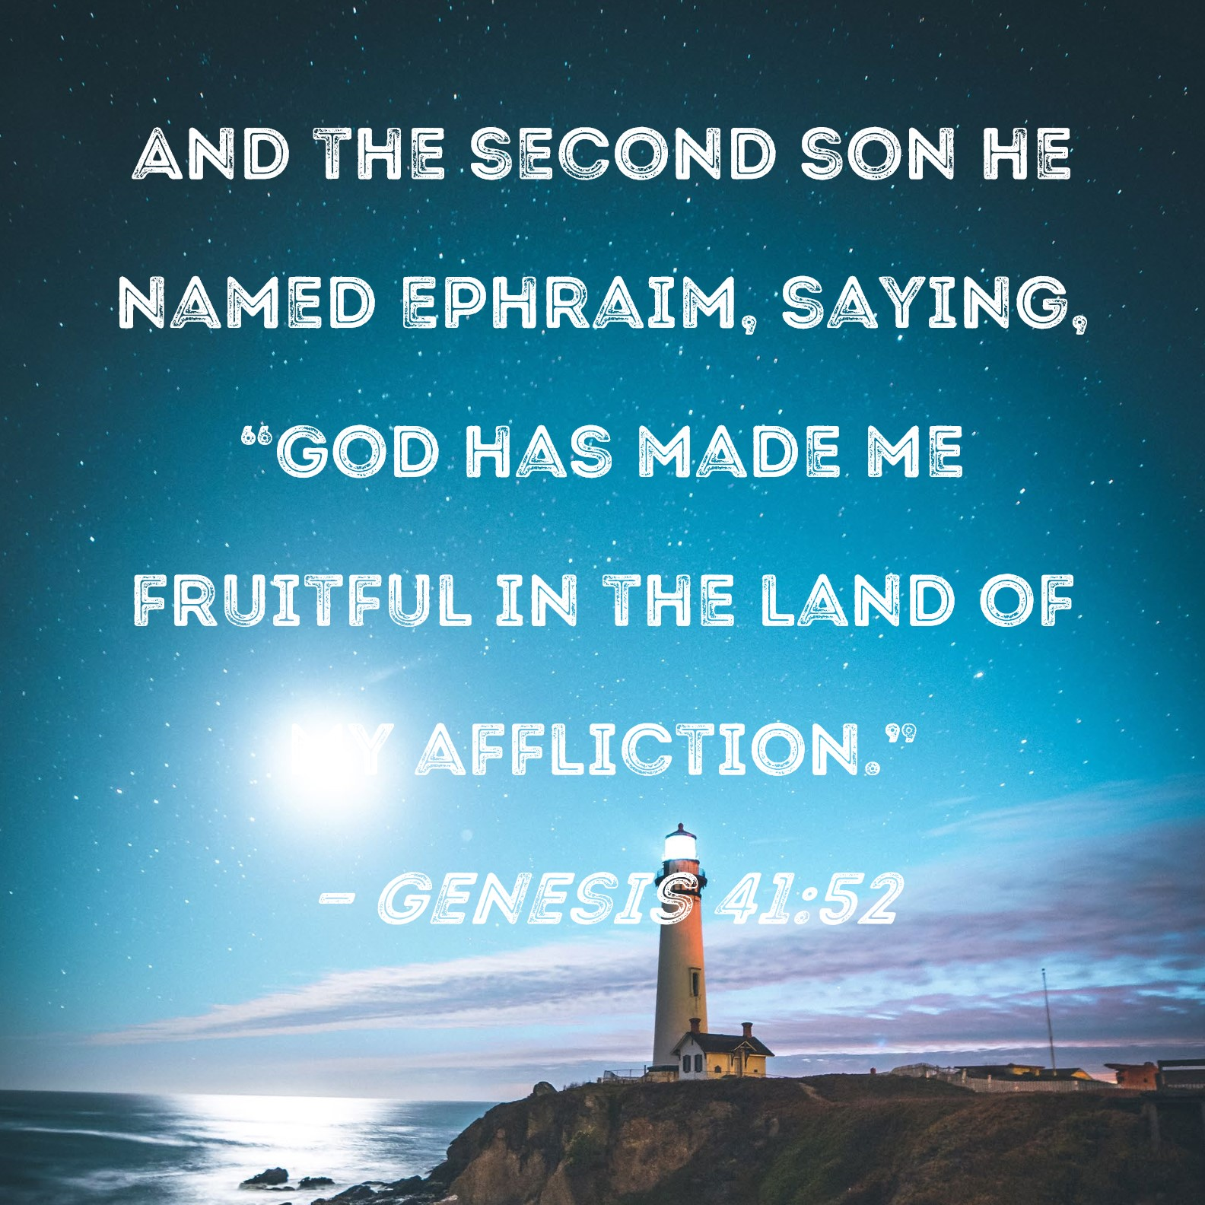

Slide 21
After the Sabbath, at dawn on the first day of the week, Mary Magdalene and the other Mary went to look at the tomb.² There was a violent earthquake, for an angel of the Lord came down from heaven and, going to the tomb, rolled back the stone and sat on it. ³ His appearance was like lightning, and his clothes were white as snow. ⁴ The guards were so afraid of him that they shook and became like dead men. ⁵ The angel said to the women, “Do not be afraid, for I know that you are looking for Jesus, who was crucified. ⁶ He is not here; he has risen, just as he said. Come and see the place where he lay. ⁷ Then go quickly and tell his disciples: ‘He has risen from the dead and is going ahead of you into Galilee. There you will see him.’ Now I have told you.”⁸ So the women hurried away from the tomb, afraid yet filled with joy, and ran to tell his disciples. ⁹ Suddenly Jesus met them. “Greetings,” he said. They came to him, clasped his feet and worshiped him. ¹⁰ Then Jesus said to them, “Do not be afraid. Go and tell my brothers to go to Galilee; there they will see me.”

Slide 22
⁵ The angel said to the women, “Do not be afraid, for I know that you are looking for Jesus, who was crucified. ⁶ He is not here; he has risen, just as he said. Come and see the place where he lay. ⁷ Then go quickly and tell his disciples: ‘He has risen from the dead and is going ahead of you into Galilee. There you will see him.’ Now I have told you.”⁸ So the women hurried away from the tomb, afraid yet filled with joy, and ran to tell his disciples. ⁹ Suddenly Jesus met them. “Greetings,” he said. They came to him, clasped his feet and worshiped him. ¹⁰ Then Jesus said to them, “Do not be afraid. Go and tell my brothers to go to Galilee; there they will see me.”

Slide 23
God Intended it for Good
1) An Empty Cross
2) An Empty Tomb

Slide 26
God Intended it for Good
1) An Empty Cross
Jesus’s atoning death was both forensic and futuristic.
People yearn to live for eternity (Ecclesiastes 3:11).

Slide 27
God Intended it for Good
1) An Empty Cross
Jesus’s atoning death was both forensic and futuristic.
2) An Empty Tomb
Jesus’ resurrection guarantees our eternal inheritance.

Slide 29
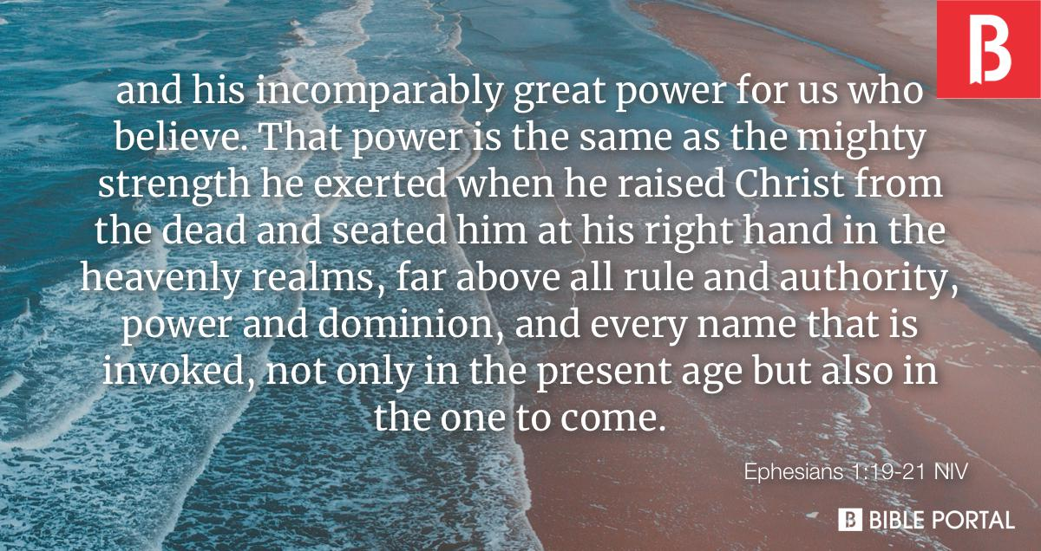

Slide 31
Acts 3:13-15, 17-18.
“(T)he God of our fathers, glorified his servant Jesus, whom you delivered over and denied in the presence of Pilate, when he had decided to release him. But you denied the Holy and Righteous One, and asked for a murderer to be granted to you, and you killed the Author of life, whom God raised from the dead. To this we are witnesses….And now, brothers, I know that you acted in ignorance, as did also your rulers. But what God foretold by the mouth of all the prophets, that his Christ would suffer, he thus fulfilled.”

Slide 32
God Intended it for Good!

